Slide 1



Lecture 1
Introduction to Data Mining
Golnaz Taheri, PhD
Senior Lecturer, Stockholm University
1

Slide 2




Course Logistics
https://ilearn.dsv.su.se/course/view.php?id=1678
Course activities:
7 weeks: 35 - 41
12 Lectures: Aug 28 – Oct 13
6 Labs & Q&A sessions
Written Exam: Oct 20
Instructor and Responsible teachers:
Golnaz Taheri
Ioanna Miliou
golnaz.taheri@dsv.su.se ioanna.miliou@dsv.su.se
2

Slide 3


Course Logistics
Course Assistants:
Luis Quintero
Maria Bampa
Zed Lee
luis-eduardo@dsv.su.se maria.bampa@dsv.su.se zed.lee@dsv.su.se
2

Slide 4
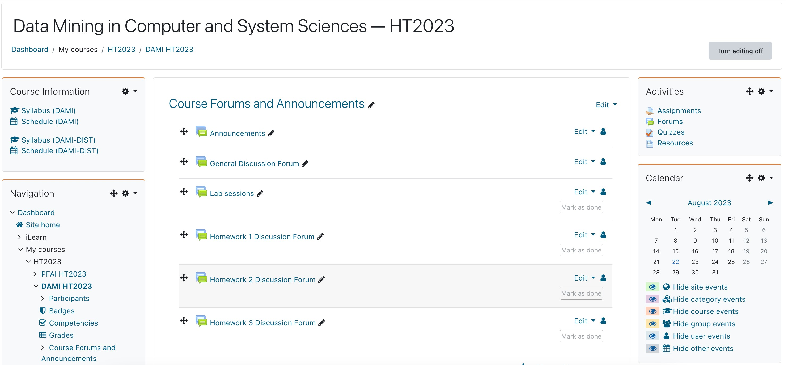
Course page on ilearn
2

Slide 5
Course Syllabus
Week 35
Week 36
Week 37 Week 39
Week 40
Week 41
Introduction to Data Mining
08/28
Dimensionality reduction
09/04
Clustering || 09/11
Classification || 09/25
Model evaluation 10/02
Advanced Topics II Graph Mining
10/09
Introduction to Python
08/30
Data Preparation using Python
09/06
Clustering using Python
09/13
Classification using Python
09/26
Advanced Topic | Neural Network
10/03
Deployment 10/10
Association Rules 08/31
Clustering | 09/07
Classification | 09/15
Classification ||| 09/29
Model Evaluation 10/05
Exam Review 10/13
2

Slide 6


Course workload
Assignments 3 hp
Three programming assignments (Python)
Online quizzes
Written Exam 4.5 hp
2

Slide 7
Homework Assignments
To be done individually (strictly)
Will involve programming in Python
Each corresponding to a lab session
Plagiarism is not acceptable, such as:
Borrowing code from the internet (chatGPT) and submitting it as is or with minor changes
Borrowing code from each other and submitting it as is or with minor changes
Borrowing code from previous years and submitting it as is or with minor changes
7

Slide 8
Homework Assignments
Submissions:
Before a given deadline
Late submissions: Not Allowed
Second deadline: November 15th
o OBS: penalty of 50% off the obtained grade

Slide 9
Quizzes
6 weekly online quizzes (lowest quiz grade to be dropped, and the best five will count)
Questions on previous lectures (1 to 3 lectures)
Only one attempt per quiz
All quizzes will be timed!
No make-up quizzes possible!

Slide 10

Homework Assignments
HW1:
HW2:
HW3:
Quizzes:
Total points:
To pass you need 12 pts
Grading scheme: A – F
pts
pts
pts
5 pts
20 pts

Slide 11
Exam
Two versions:
DAMI: on-campus
DAMI-DIST: online
Two parts:
Part A: multiple-choice questions Part B: free text questions
This will examine your ability on what you have learned
To pass you need at least 60% of the points
Grade scheme: A – F
11

Slide 12
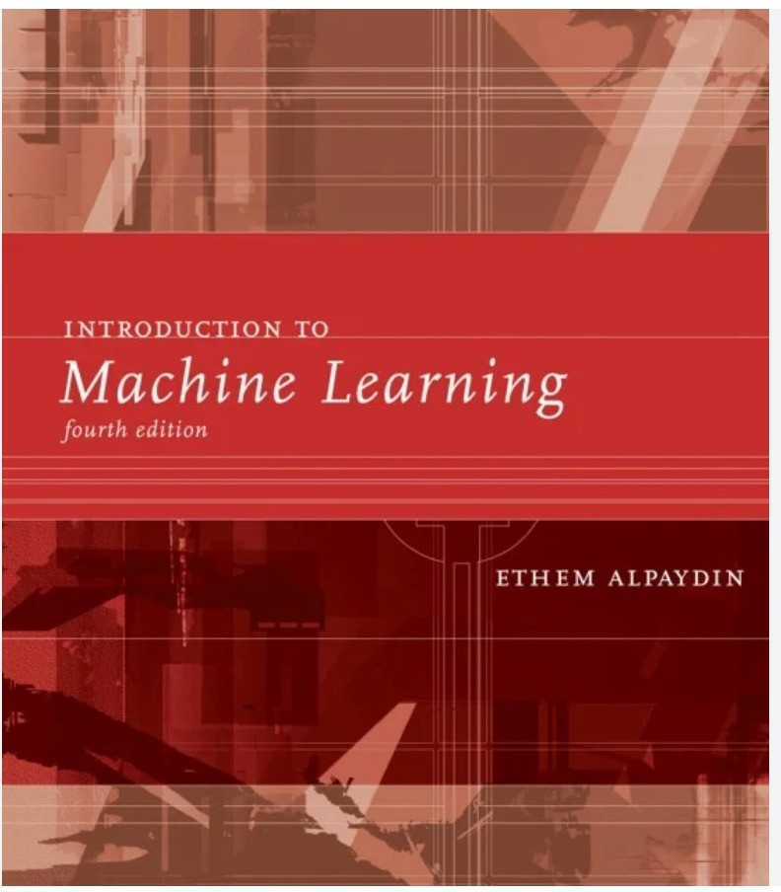
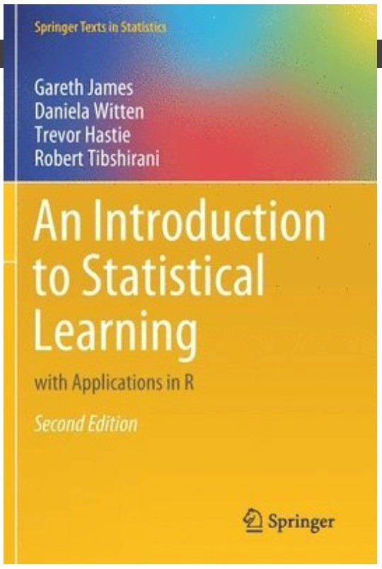
Course textbook
Main:
Introduction to Machine Learning (fourth edition) Publisher: MIT Press
Year: 2022
ISBN: 978-0-2620-4379-3
Additional:
An Introduction to Statistical Learning with applications in R Publisher: Springer
Year: 2013
ISBN: 978-1-4614-7138-7
URL: http://www-bcf.usc.edu/~gareth/ISL/

Slide 13
Learning Objectives
Become familiar with data science and its algorithms
Be able to identify a correct algorithmic solution to a given problem
Be able to apply these algorithmic solutions to solve practical problems
Be able to perform basic data analysis on real data using Python

Slide 14
Introduction
Why we need Data Analysis?
What is Data Science (DS) ?
What is Data Mining (DM) ?
What is Artificial Intelligence (AI)?
What is Machine Learning (ML) ?

Slide 15
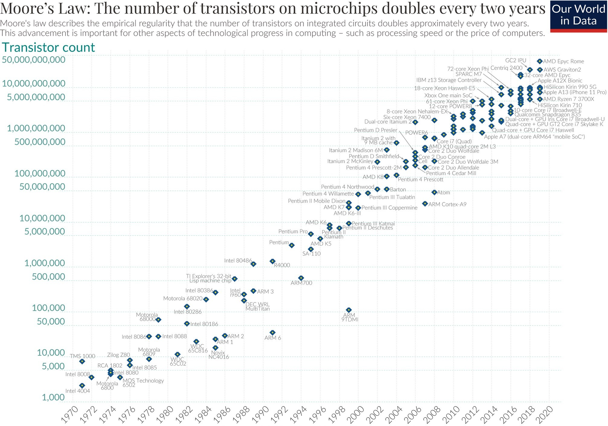
Why we need Data Analysis?
Computational power
More efficient processors, larger memories

Slide 16


Why we need Data Analysis?
Data collection and transfer
Communication and measurement technologies have improved
Data storage
Huge hard disks
Data on the cloud

Slide 17
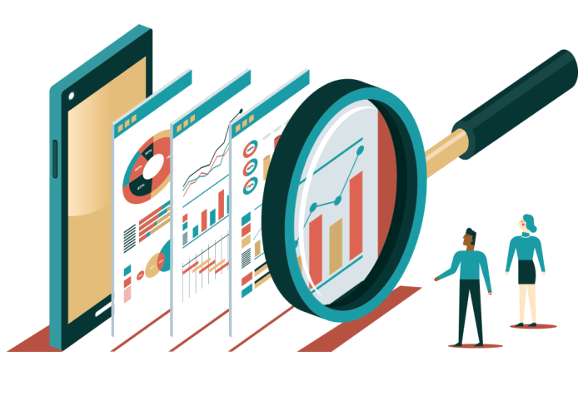
Why we need Data Analysis?
It is possible to collect and store lots of raw data
But…data analysis methods are lagging behind
Need to analyze the raw data to extract knowledge

Slide 18
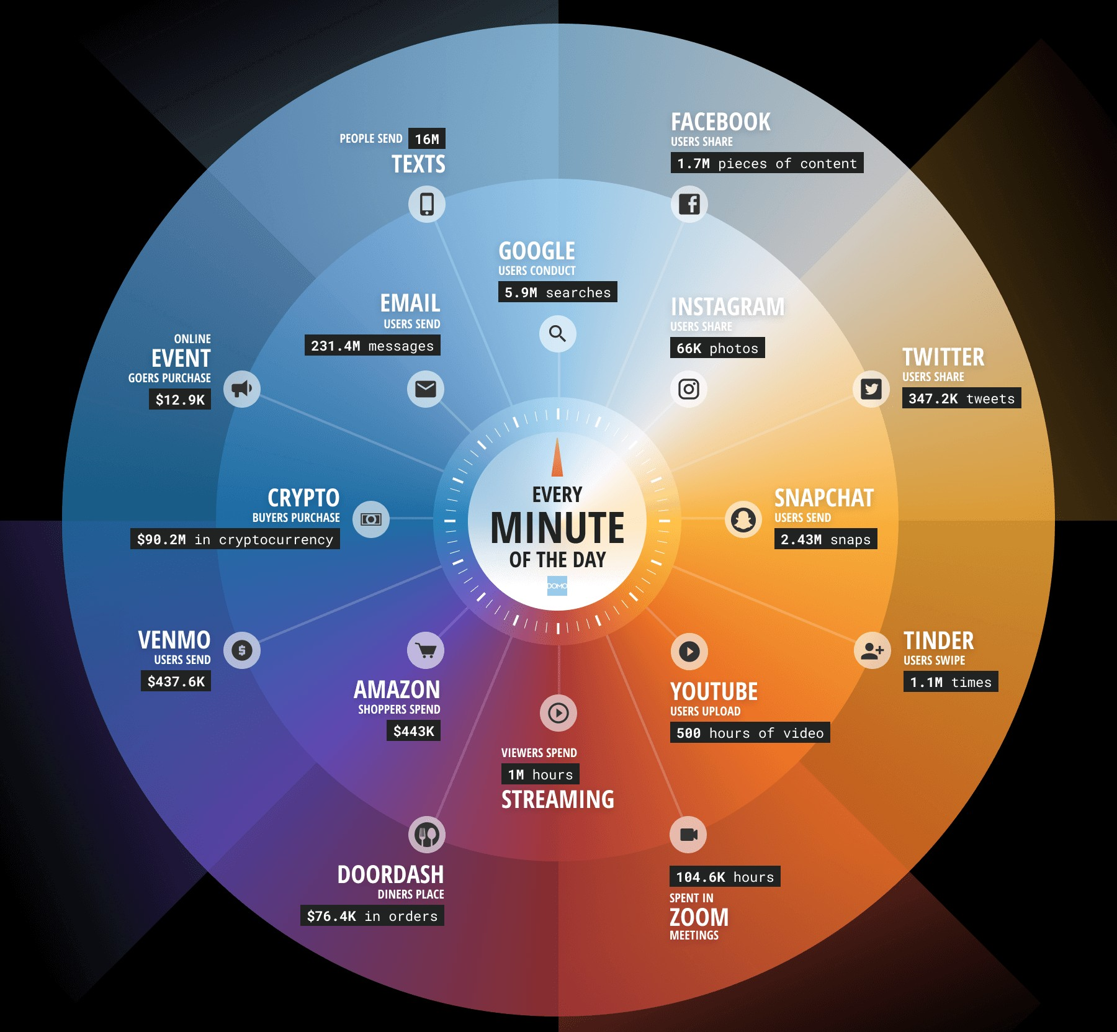
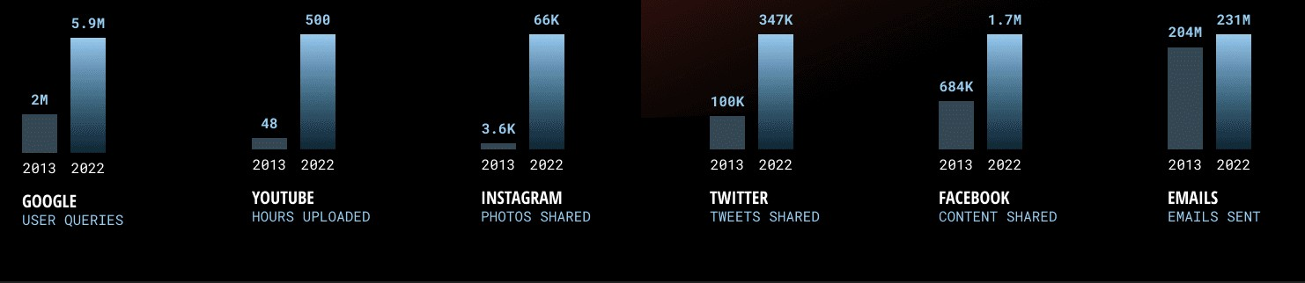
Data Never Sleeps!

Slide 19
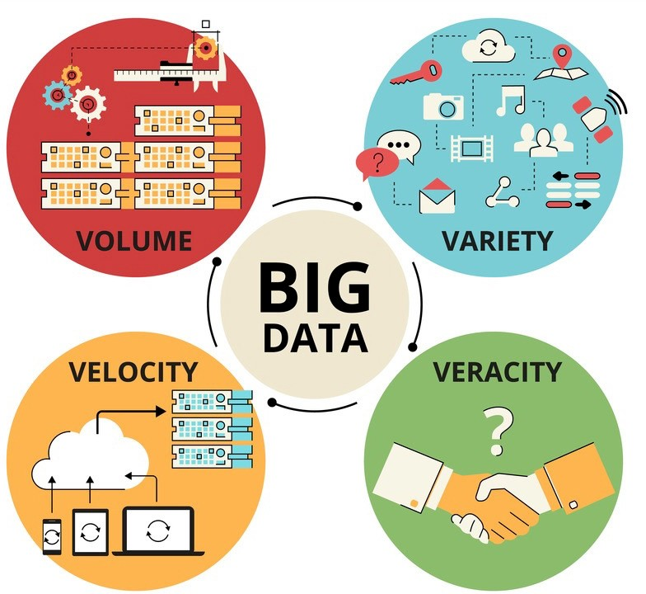
The Four V's of Big Data
Volume: The first V of big data is all about the amount of data.
Velocity: The second V of big data, is all about the speed new data is generated and moves around.
Variety: Data is generally one of three types: unstructured, semi-structured and structured and algorithms required to process the variety of data generated varies based on the type of data to be processed.
Veracity: Denotes the trustworthiness of the data. Is the data accurate and high-quality?
19

Slide 20
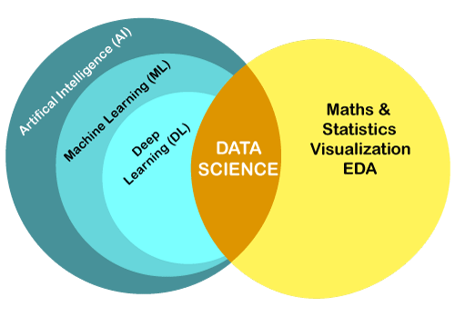
What is Data Science
Data science is an interdisciplinary field that uses statistics, scientific computing, scientific methods, algorithms and systems to extract knowledge and insights from structured, and unstructured data.

Slide 21
Why Data Science is important?
Data science is revolutionizing the way companies operate. Many businesses, regardless of size, need a robust data science strategy to drive growth and maintain a competitive edge.
DS allows businesses to uncover new patterns and relationships that have the potential to transform the organization
DS can reveal unnoticed gaps and problems. Greater insight about
purchase decisions, customer feedback, and business processes can
drive innovation in internal operations and external solutions.
DS can help companies predict change and react optimally to different
circumstances
.

Slide 22
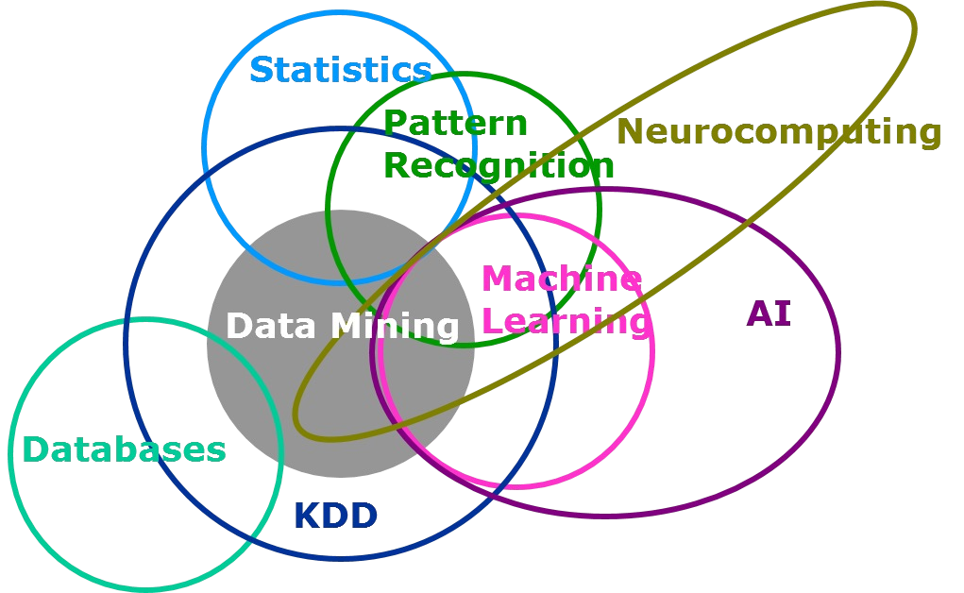
What is Data mining
Data mining is the process of extracting and discovering patterns in large data sets.
The overall goal of data mining is extracting information (with intelligent methods) from a data set and transforming the information into an understandable structure.
Data mining is the analysis step of the "knowledge discovery in
databases" process, or KDD.

Slide 23
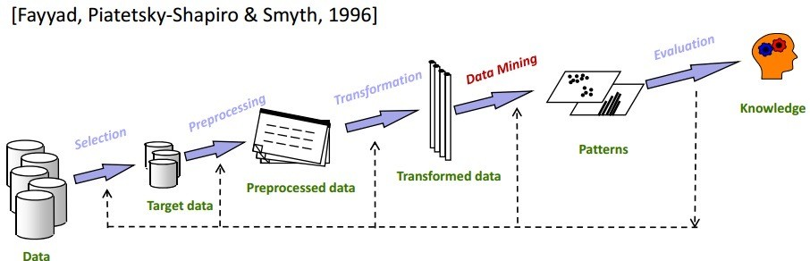
What is KDD
•
Knowledge Discovery in Databases (KDD) is a process that involves the
extraction of useful, previously unknown, and potentially valuable
information from large datasets.
KDD is a multi-step process that encourages the conversion of data to useful information. Data mining is one of the steps of KDD which is the pattern extraction phase of KDD.

Slide 24
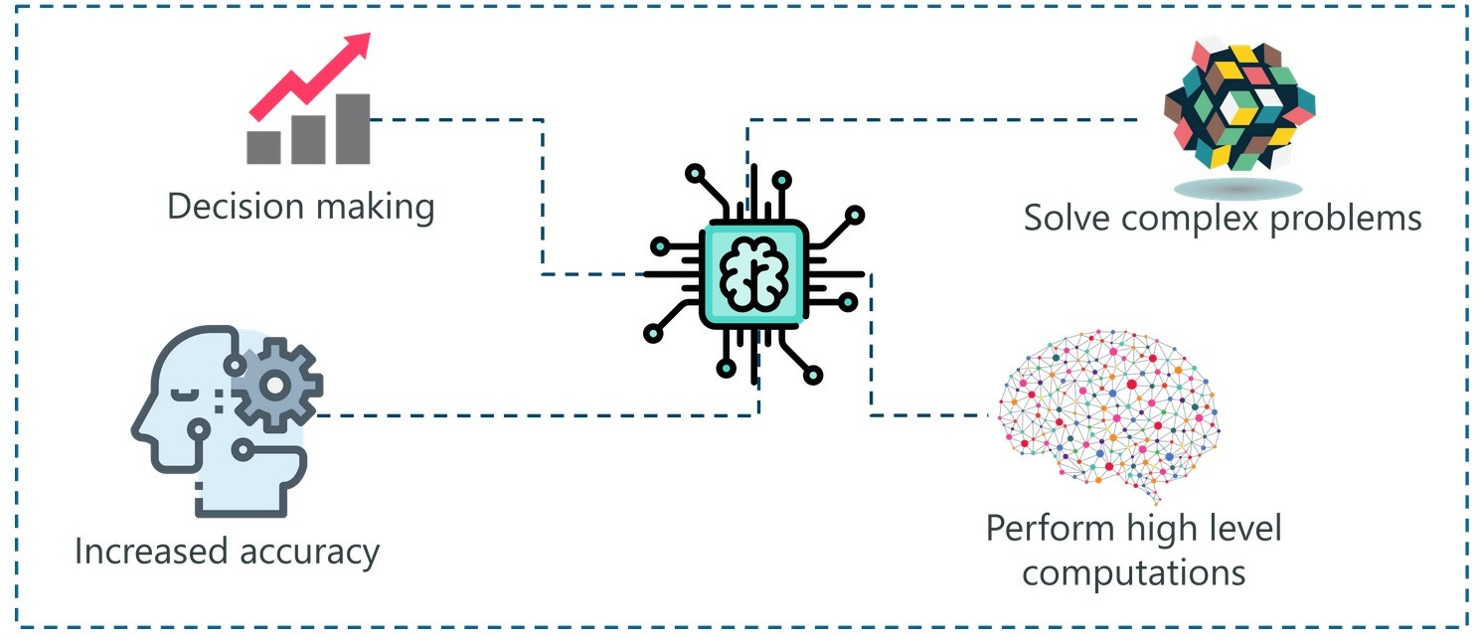
What is Artificial Intelligence
In 1956,
the term Artificial Intelligence (AI) was defined by John
McCarthy as:
‘The science and engineering of making intelligent machines.’
AI is a machine's ability to perform the cognitive functions we associate with human minds, such as reasoning, learning, interacting with an environment, problem solving, and even exercising creativity.

Slide 25

AI example
Chatbots
Answering a customer's inquiries can take a long time.
The use of algorithms to train machines to meet customer needs through chatbots is an AI solution.
This allows machines to answer as well as take and track orders.

Slide 26
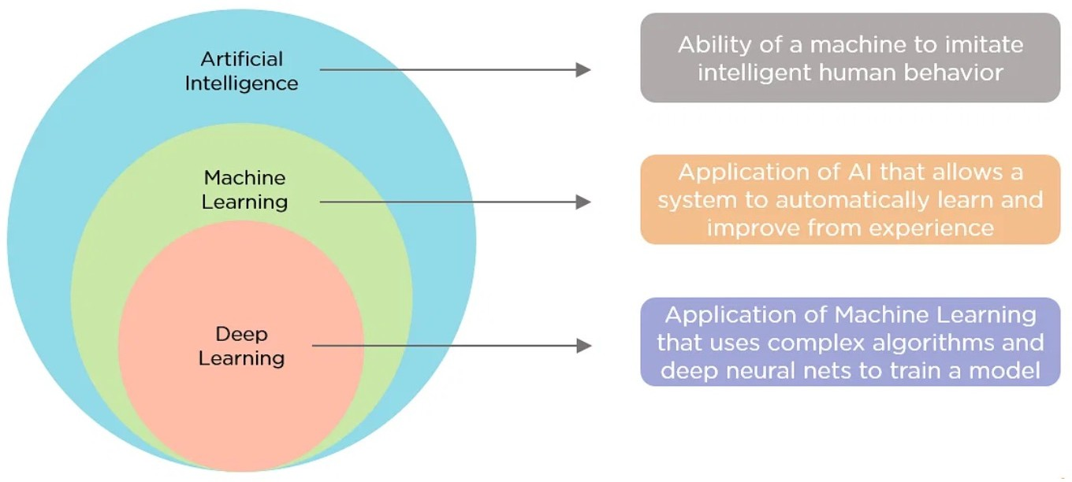
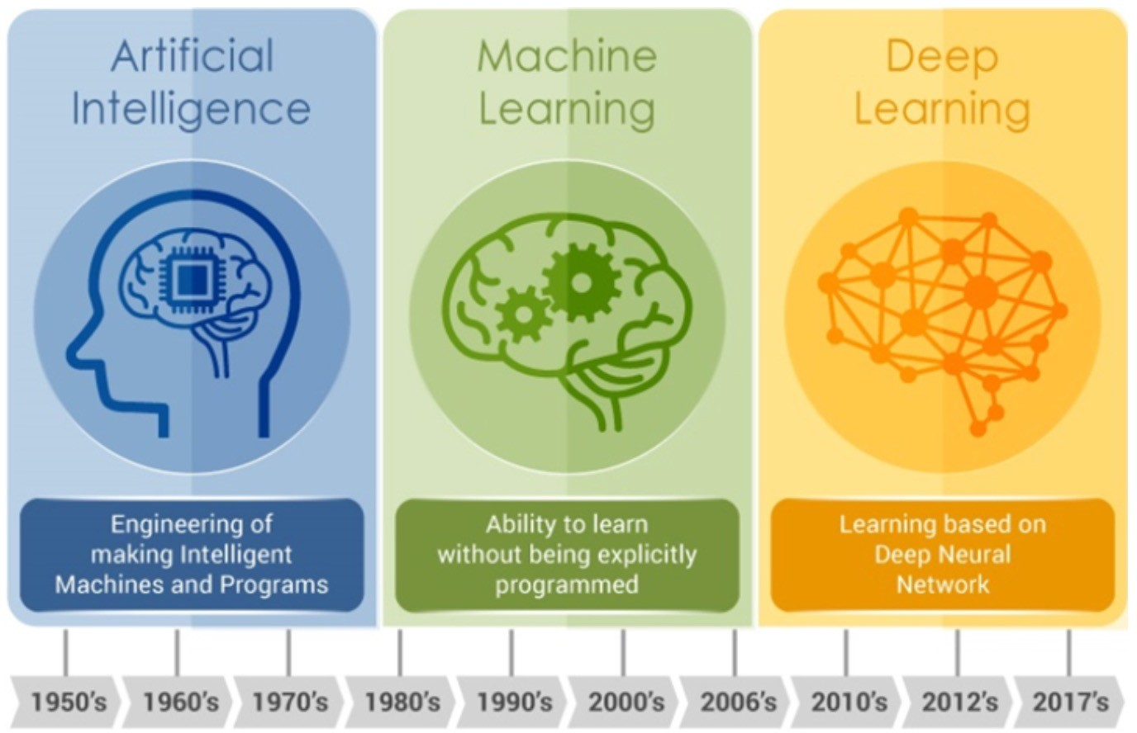
What is Machine Learning
Machine learning is a branch of AI and computer science which focuses on the use of data and algorithms to imitate the way that humans learn, gradually improving its accuracy.

Slide 27
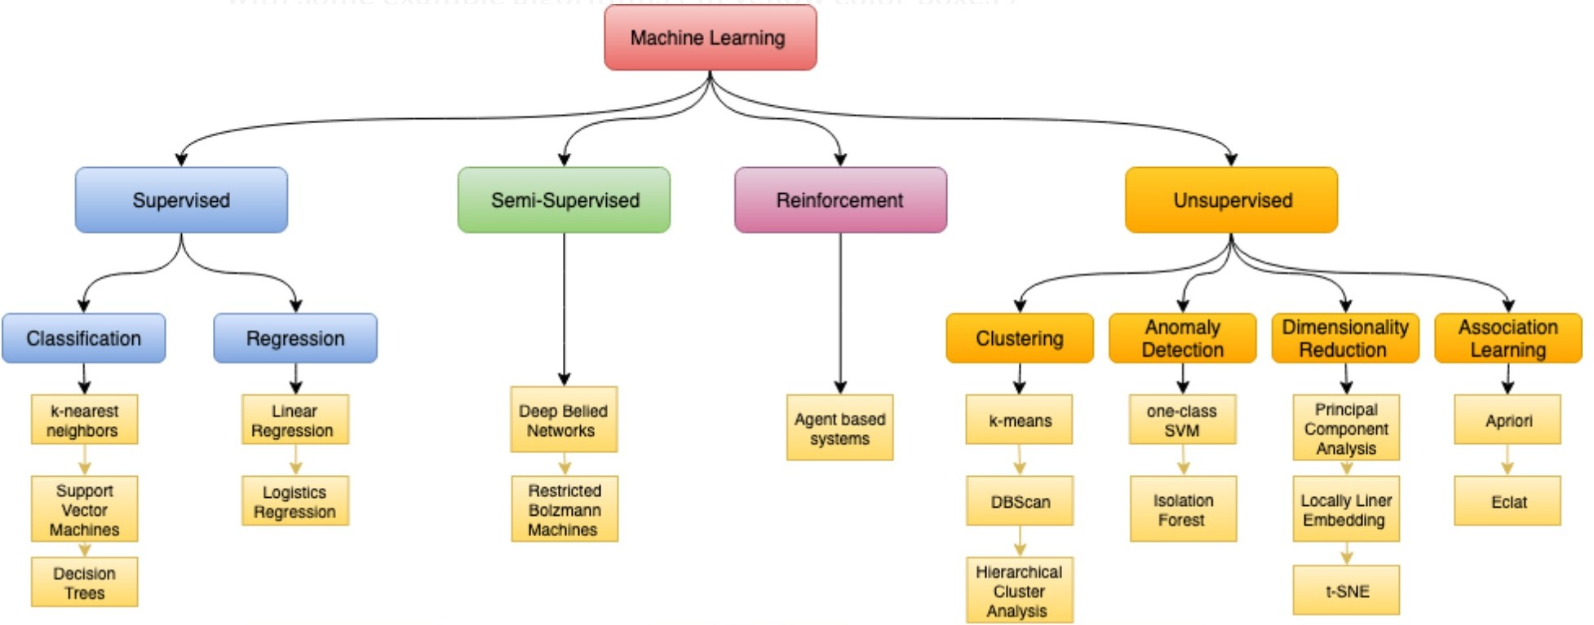
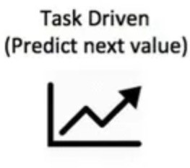
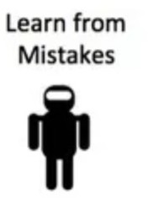
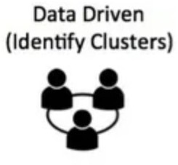
Types of Machine Learning

Slide 28


Thanks!
golnaz.taheri@dsv.su.se

